Slide 1
Time Series

Slide 2
Objectives
Definition of time series
Forecasting
Seasonality
Naive forecasting
Performance Evaluation
Mean Absolute Error (MAE)
Mean Absolute Percentage Error (MAPE)
Mean Squared Error (MSE)
Long-Term Patterns
Moving Average Models
Autoregressive Moving Average (ARMA)
Autoregressive Integrated Moving Average (ARIMA)
Seasonal ARIMA (SARIMA)
Recurrent Neural Networks (RNN)
Memory Cell
Recurrent Layer and architectures
Backpropagation Through Time (BPTT)

Slide 3
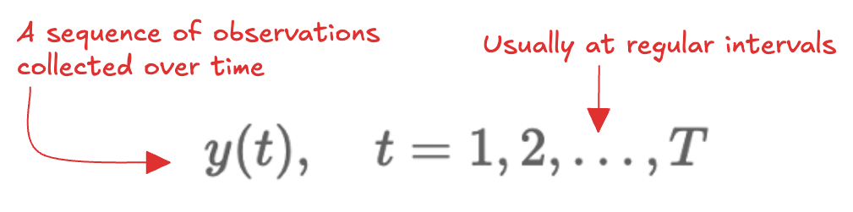
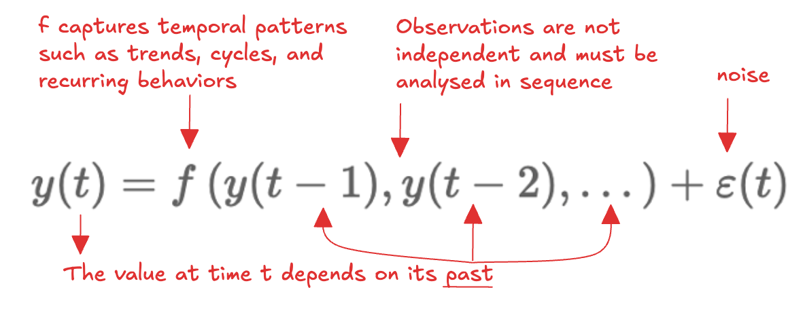
Definition of time serie
Examples:
Daily active users on a website
Hourly temperature in a city
Daily household energy consumption
Temporal ordering matters
Why time series analysis? Learn from past data (trends, seasonality, cycles)

Slide 4

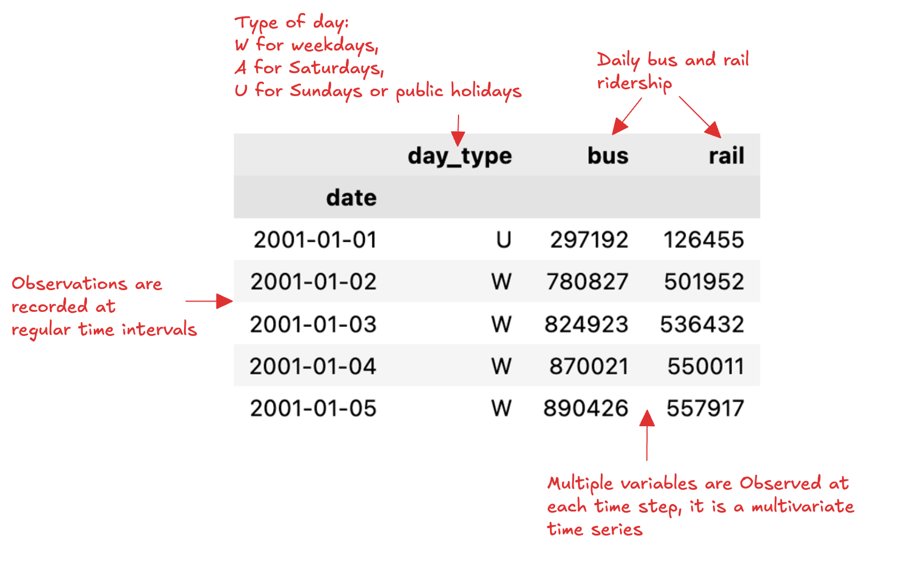
Chicago Transit Authority Dataset
Example

Slide 5
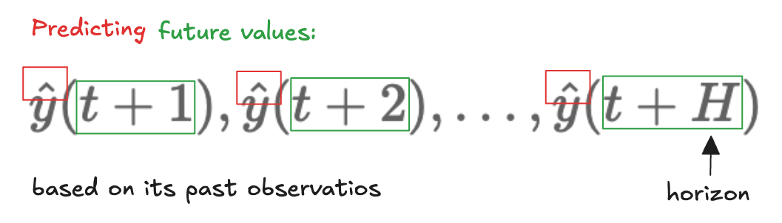
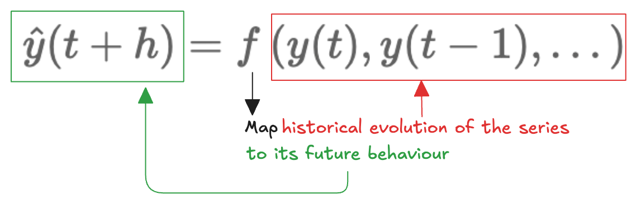
Forecasting
Learn a function:
Assumption underlying temporal patterns remain stable!
Given the observed ridership up to today…
…forecast tomorrow’s demand or the ridership over the next week
Applications:
Operational planning
Resource allocation
Service optimization

Slide 6
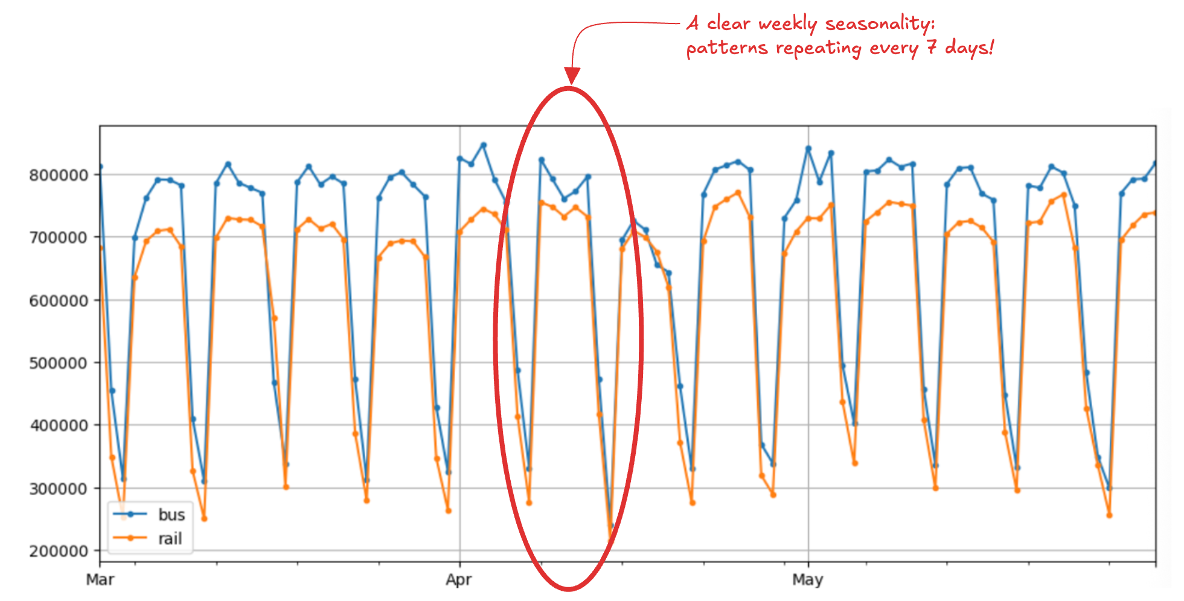
Seasonality
Plot of the ridership over few months in 2019

Slide 7
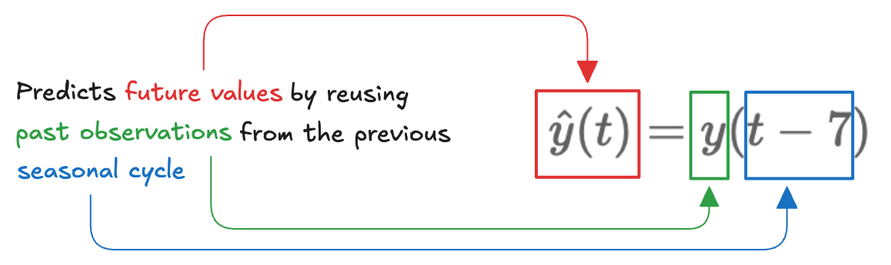
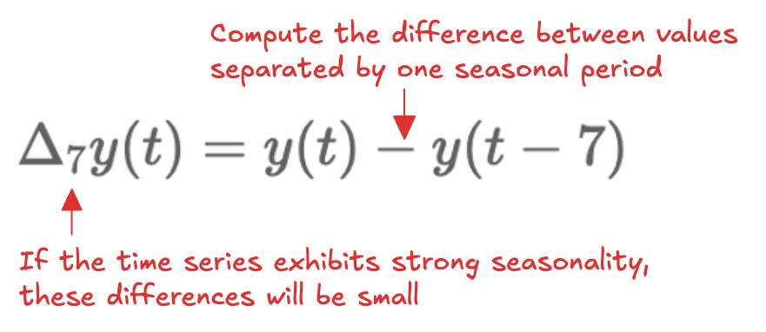
Naive forecasting
Simple, yet often a strong baseline
Make seasonality visible:
The Pandas diff() method computes the difference between each observation and the value recorded a specified number of periods earlier

Slide 8
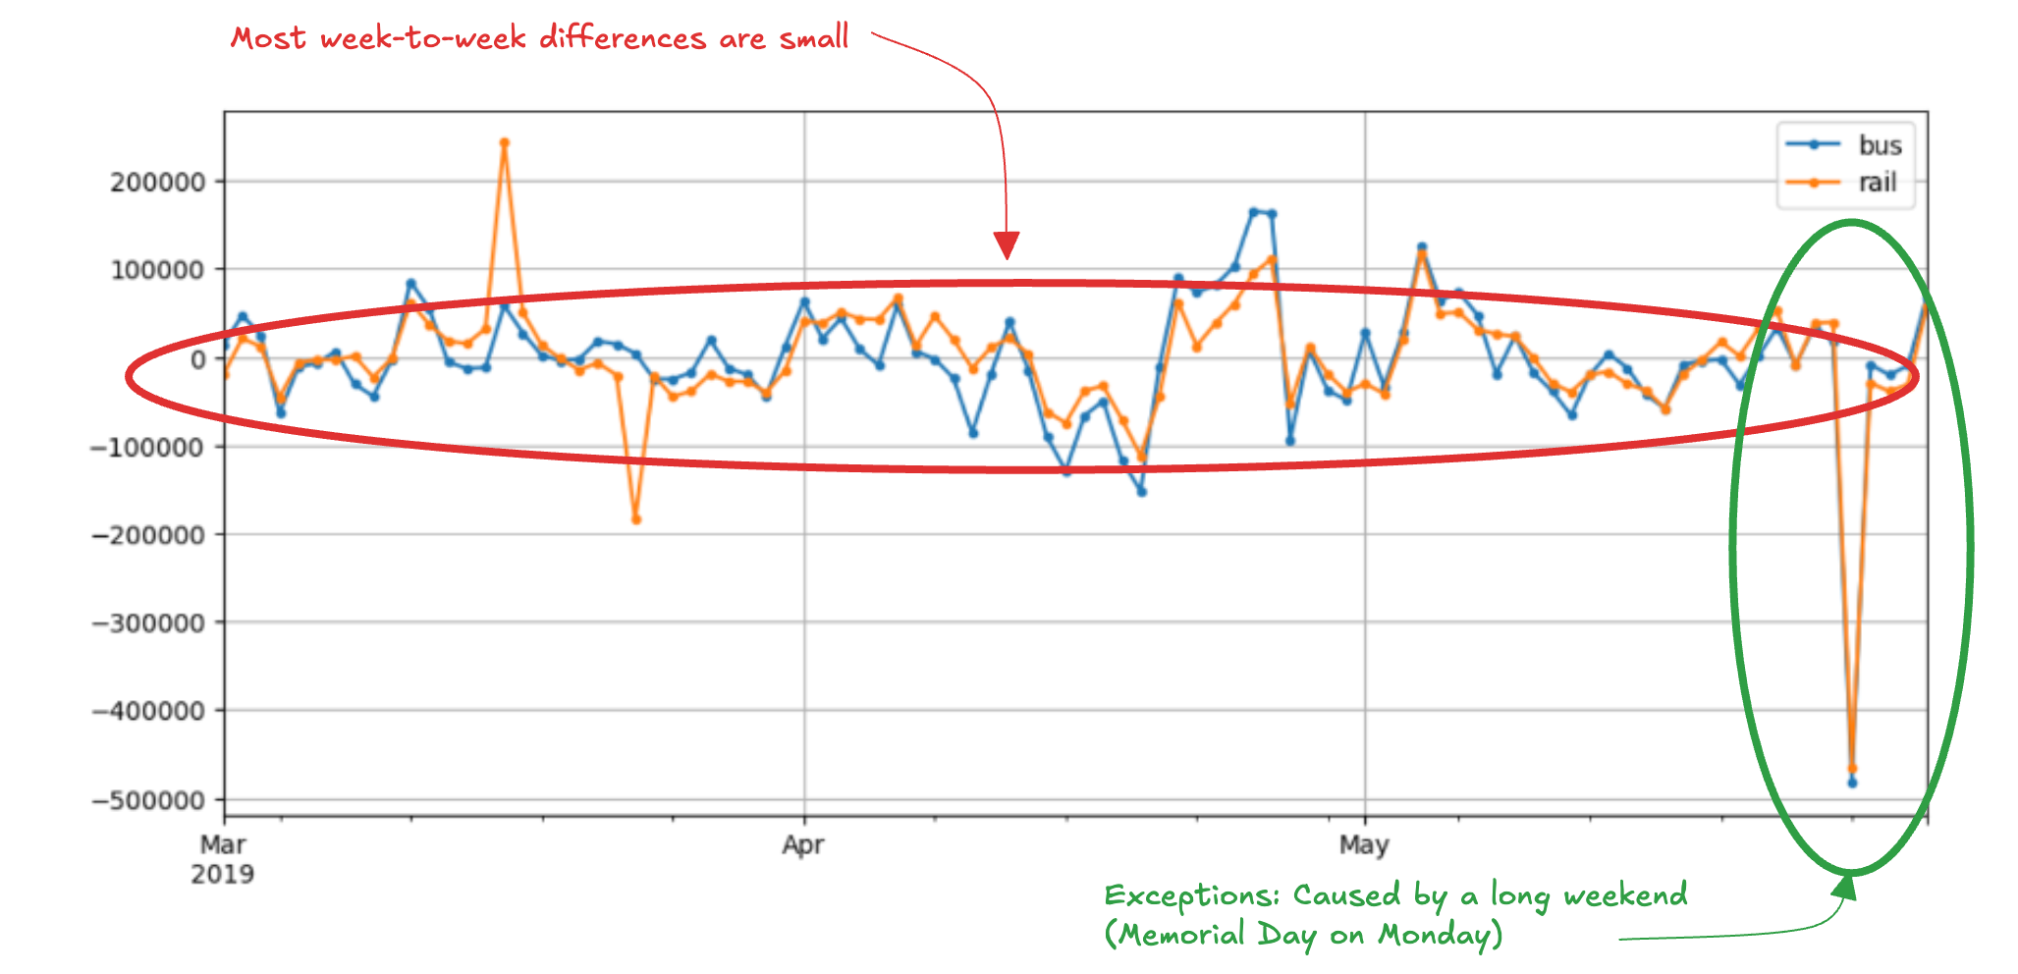
Autocorrelation
Readership shows strong weekly pattern
When a series is strongly correlated with a time-shifted version of itself, it exhibits autocorrelation

Slide 9
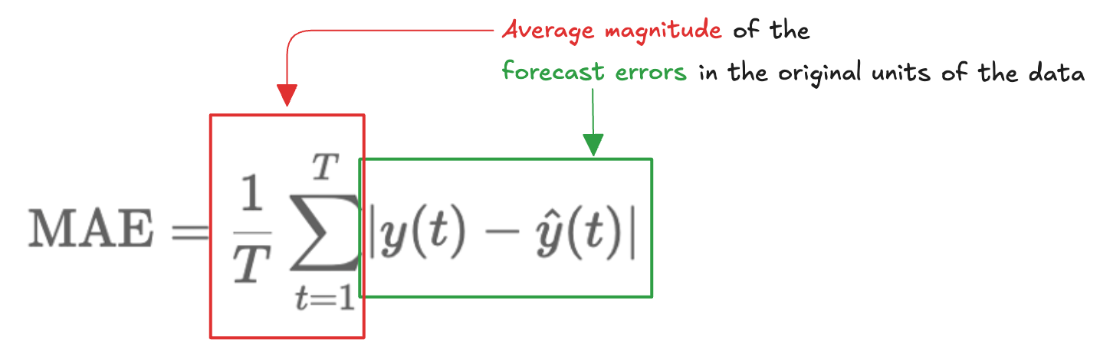
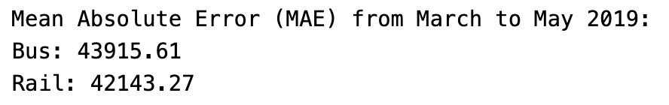
Mean Absolute Error (MAE)
Quantitative assessment
How far the predictions are, on average, from the true observations:
Absolute errors are hard to interpret (large or small?):

Slide 10
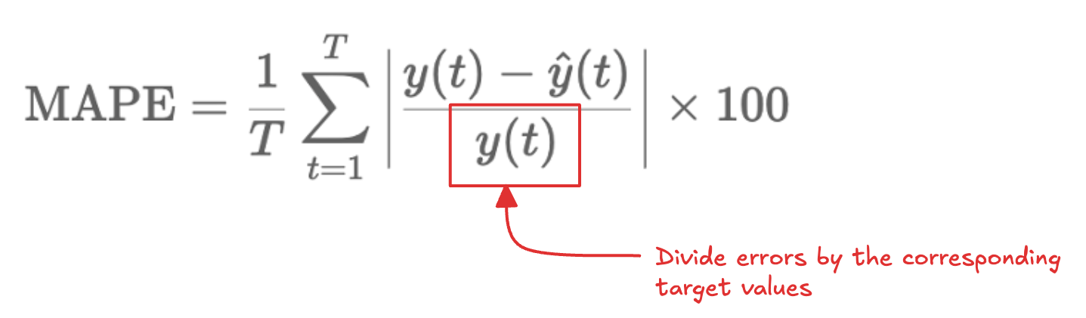
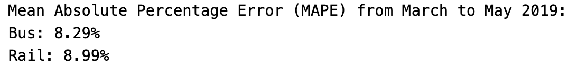
Mean Absolute Percentage Error (MAPE)
We can normalize by the true values:
Relative errors show that bus forecasts are slightly more accurate
Bus ridership volumes are higher → larger absolute errors

Slide 11
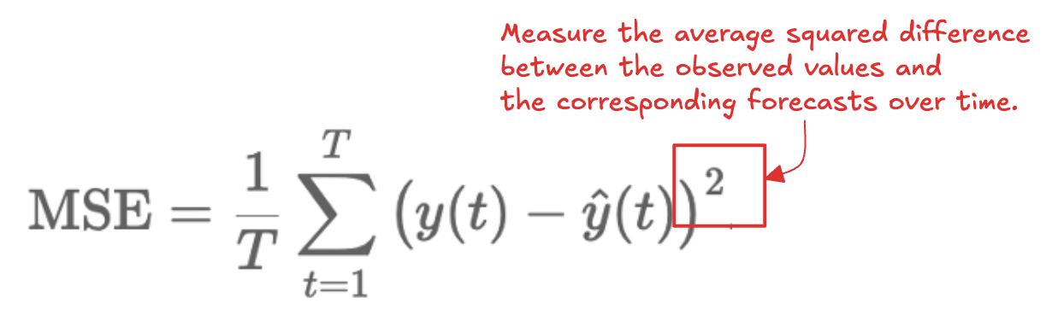
Mean Squared Error (MSE)
Penalize large forecast errors heavily than small ones
Particularly sensitive to outliers and abrupt deviations
Useful when large errors are especially undesirable
Metric choice depends on the task and data scale

Slide 12
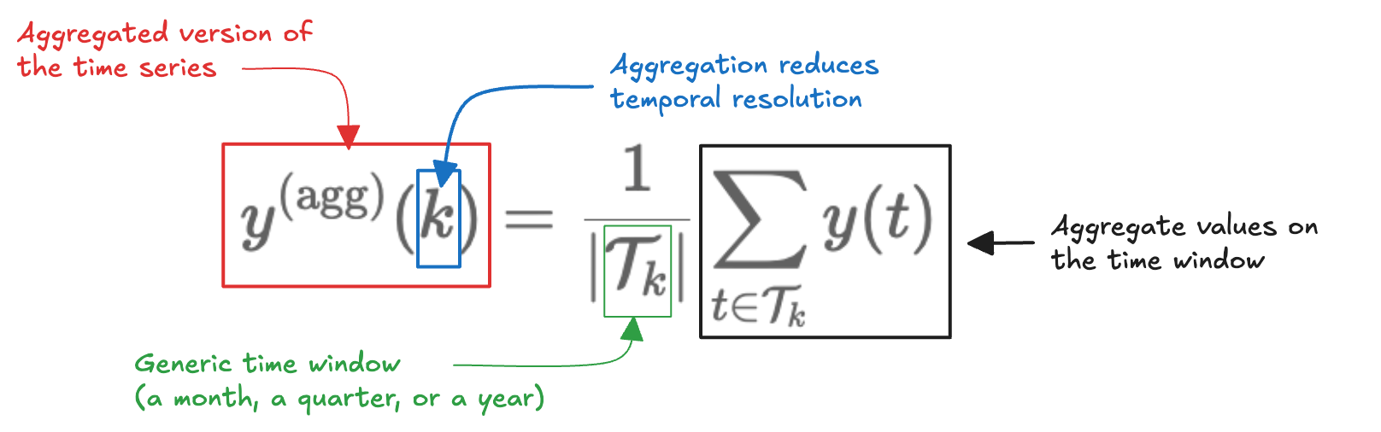
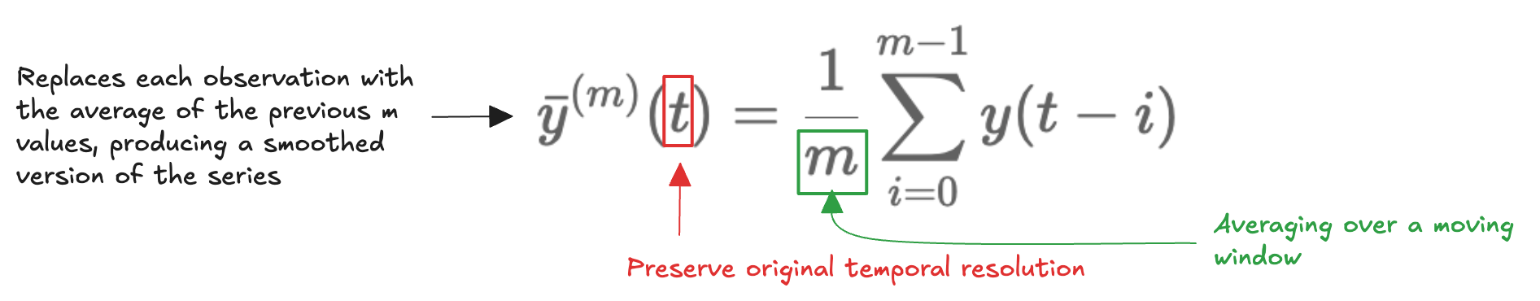
Long-Term Patterns (1)
Difficult to identify clear trends beyond the strong weekly seasonality
We can analyse at different temporal scales by aggregating:
Aggregation can obscure how patterns evolve, we use rolling statistics
Pandas resample() and rolling() methods

Slide 13
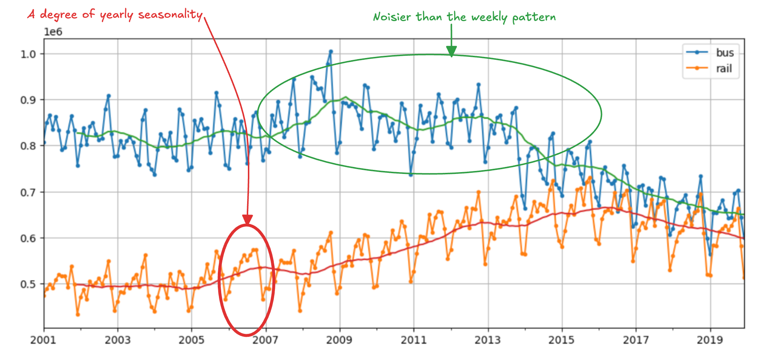
Long-Term Patterns (2)
Analyse data from 2001 to 2019 both the monthly aggregated series and its 12-month rolling average

Slide 14
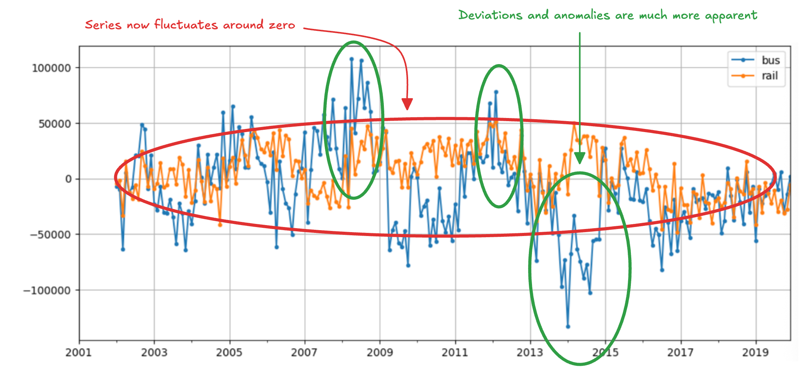
Long-Term Patterns (3)
Applying a 12-month differencing:

Slide 15
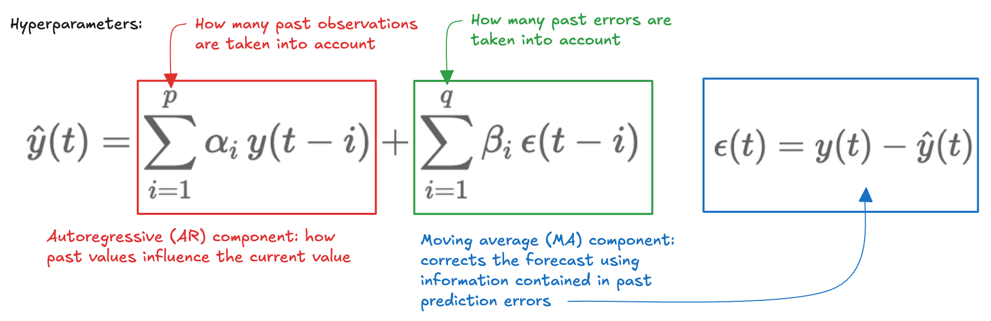
Autoregressive Moving Average (ARMA) (1)
Combines past values and past forecast errors
Balanc
Parameters alpha and beta are fitted to data, using methods like maximum likelihood estimation
Hyperparameters p and q determine how many past observations and past errors are considered
How do we choose p and q?

Slide 16
Autoregressive Moving Average (ARMA) (2)
Start with small values of p and q
Fit the model and estimate the parameters
Examine the residual diagnostics
If residuals resemble white noise, the model is adequate
If systematic patterns remain, increase p and/or q
If added complexity brings no improvement, further parameters may cause overfitting
Balance model expressiveness (ability to capture temporal dependencies) and parsimony (keeping the model as simple as possible)

Slide 17
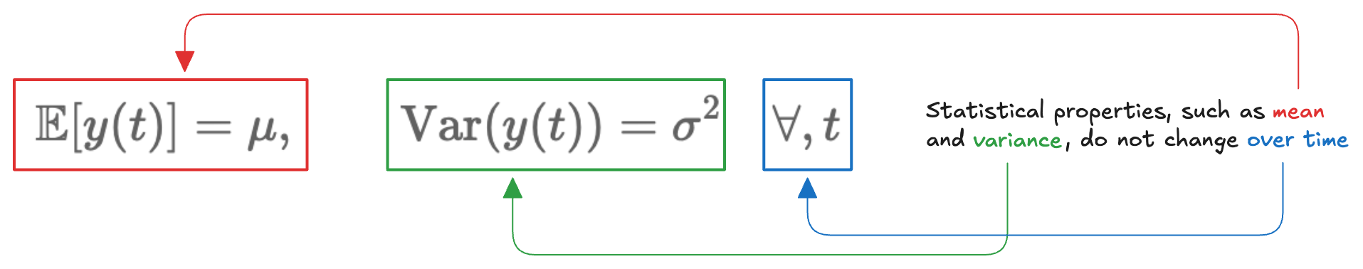
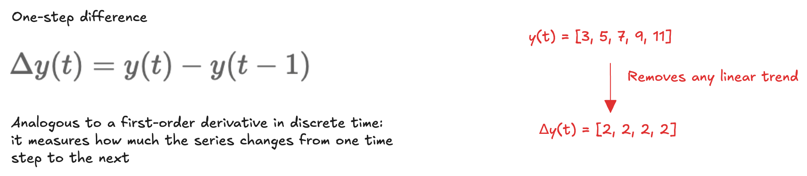
Differencing (1)
ARMA works well for stationary time series:
Trends and evolving patterns violate the assumption; differencing can be used:

Slide 18
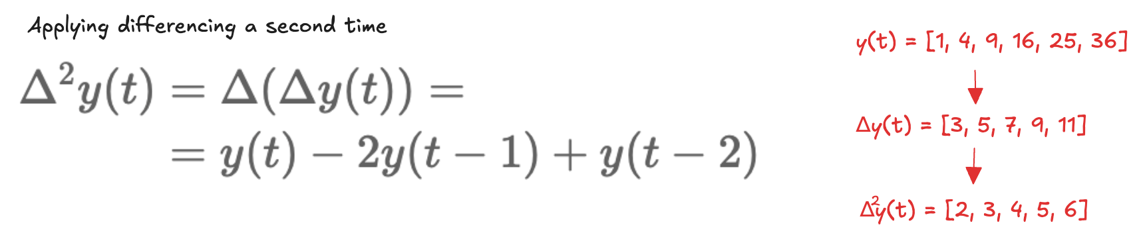
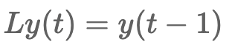
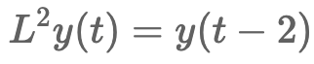
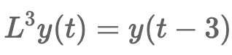
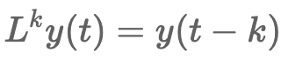
Differencing (2)
If the series follows a quadratic trend, a single round of differencing is not sufficient:
A convenient notation is the lag operator L:
…

Slide 19
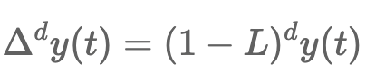
Differencing (3)
Using this notation:
We can use the d-th derivative to remove polynomial trends up to degree d
…

Slide 20
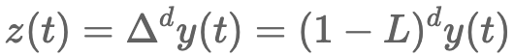
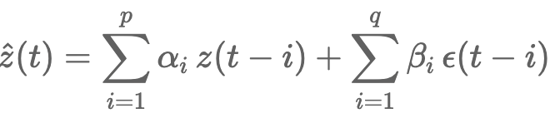
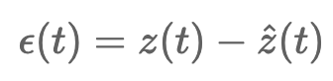
Autoregressive Integrated Moving Average (ARIMA)
Before modelling temporal dependencies, the series is first flattened through differencing so that its statistical properties remain stable over time:
An ARMA model is then applied to the differenced series:
Characterized by three hyperparameters: p and q (as in ARMA), and the additional parameter d, which controls the degree of differencing

Slide 21
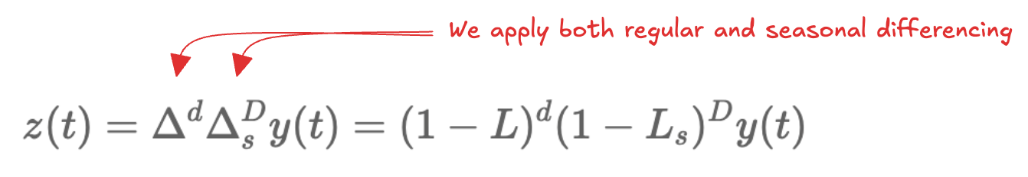
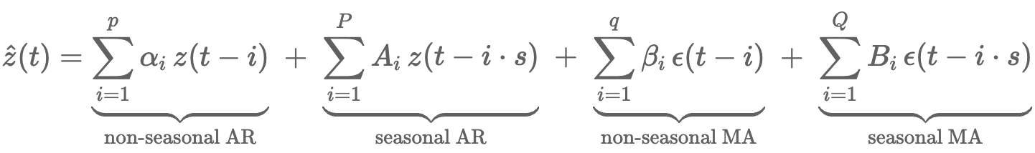
Seasonal ARIMA (SARIMA)
A natural extension, which explicitly accounts for seasonal patterns
Key idea: many time series evolve on different scales simultaneously
a short-term scale, capturing local dynamics from one time step to the next
a seasonal scale, capturing patterns that repeat every s time steps
ARIMA models only the short-term structure, SARIMA augments it by introducing additional autoregressive and moving-average components that operate at the seasonal lag.
Together, these components allow SARIMA to represent both local dynamics and long-range seasonal structure within a unified framework.

Slide 22
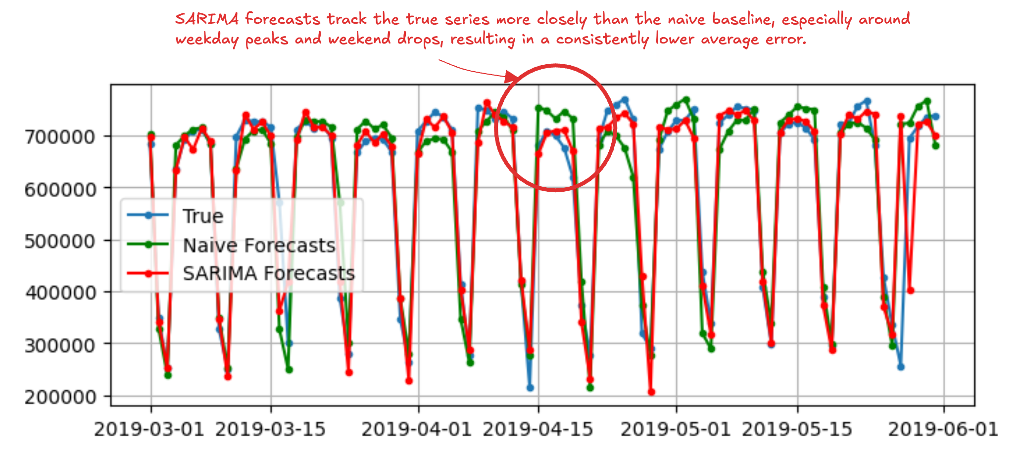
Statsmodels library
Python package for classical statistical modelling and time series analysis
Provide implementations of ARMA, ARIMA, and SARIMA models, along with a wide range of statistical diagnostics and hypothesis tests.
We can exploit this library to fit a SARIMA model to the rail time series:

Slide 23
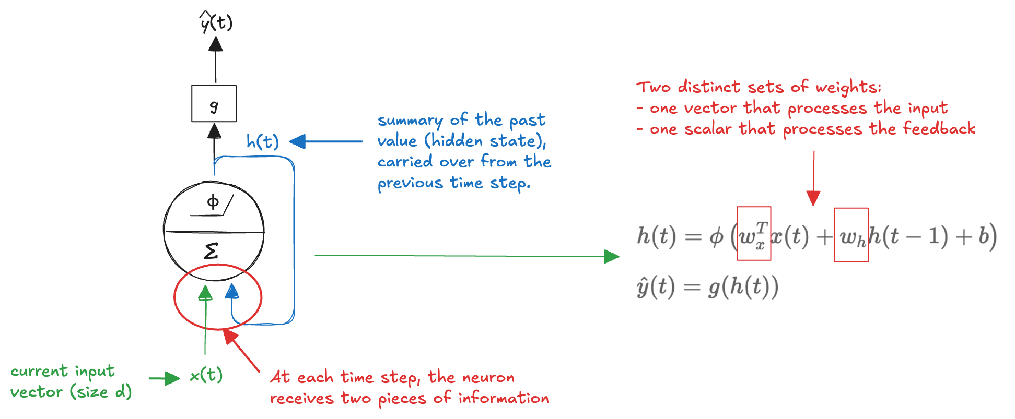
Recurrent Neuron
In feedforward NN, information flows in one direction: from input to the output
Predictions are made independently, without any memory of past inputs
This makes feedforward networks poorly suited for time series
Current value often depends on what happened before
We can address this limitation by introducing feedback connections
The network feeds part of its output back into itself
An internal state that acts as a memory
Recurrent neuron:
The model explicitly captures temporal dependencies

Slide 24
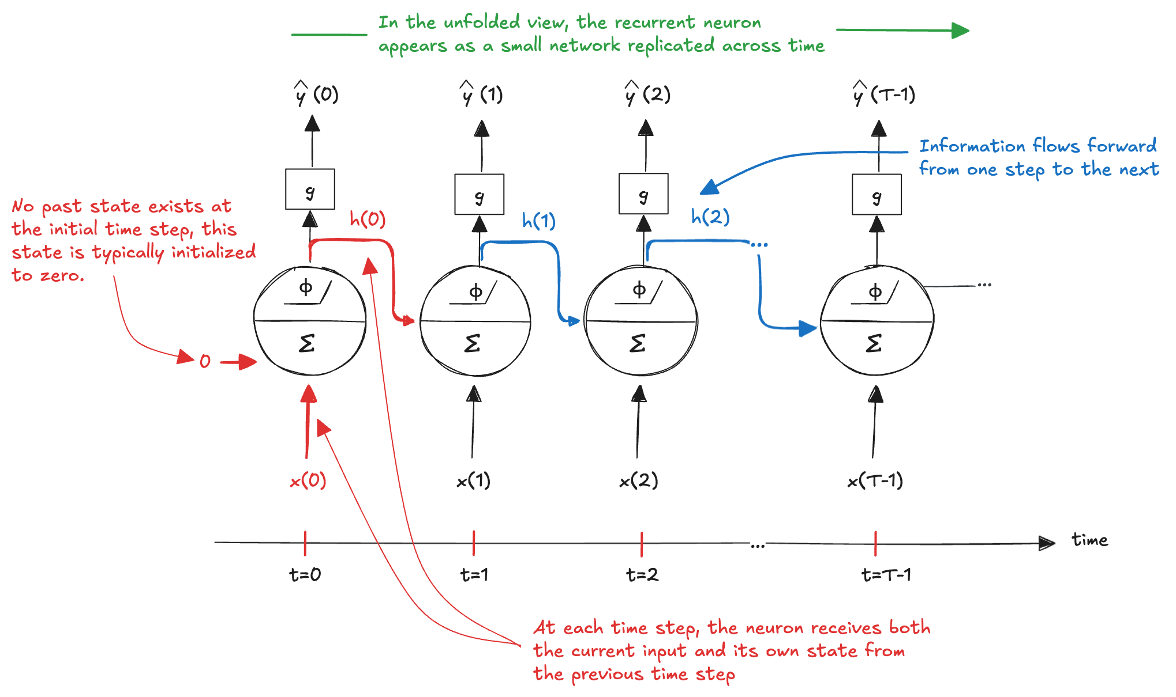
Unrolling through time
The same recurrent neuron is replicated across time steps to explicitly represent how its state evolves:

Slide 25
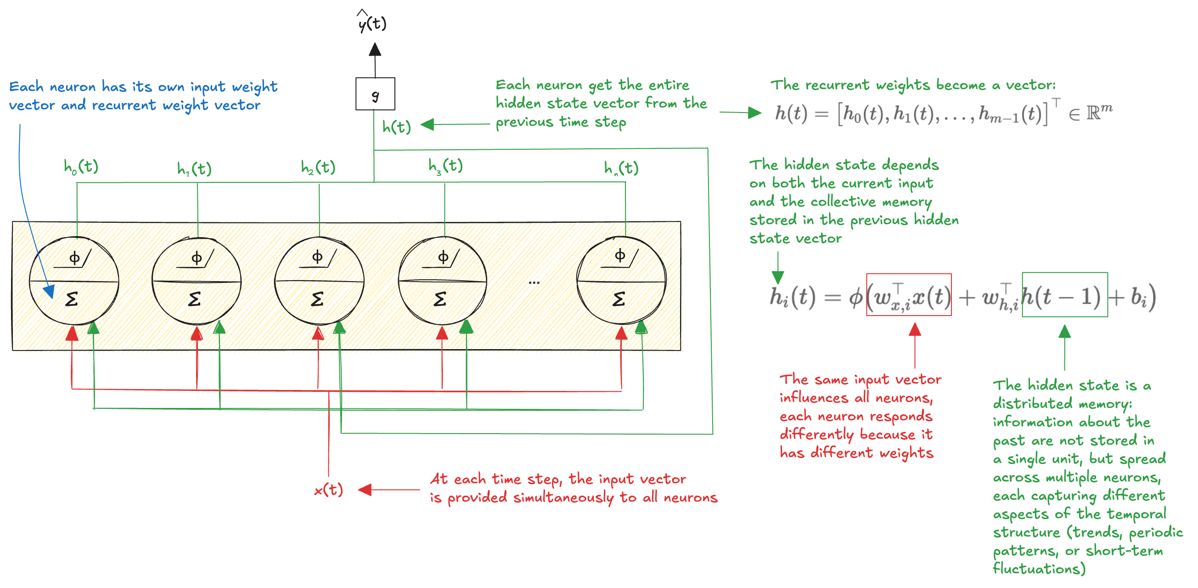
Recurrent Layer
Several recurrent neurons operating in parallel, where the single neuron looks at everything we knew before, not just at its own previous state:

Slide 26
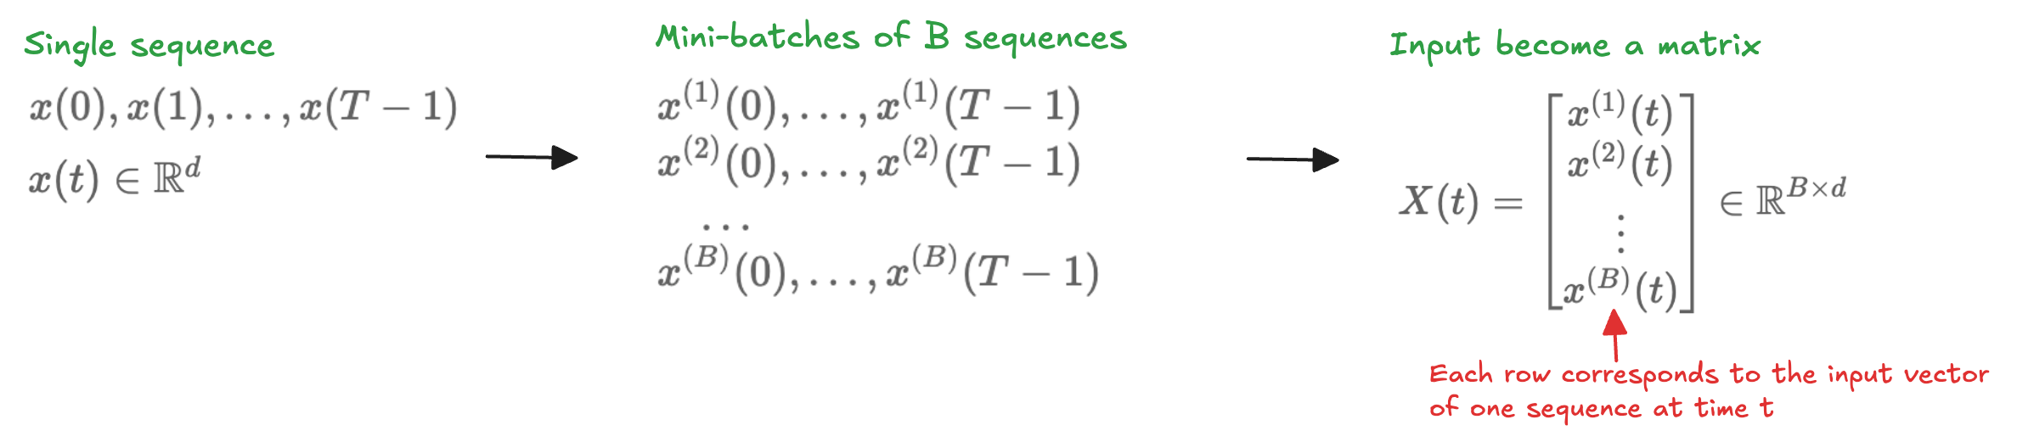
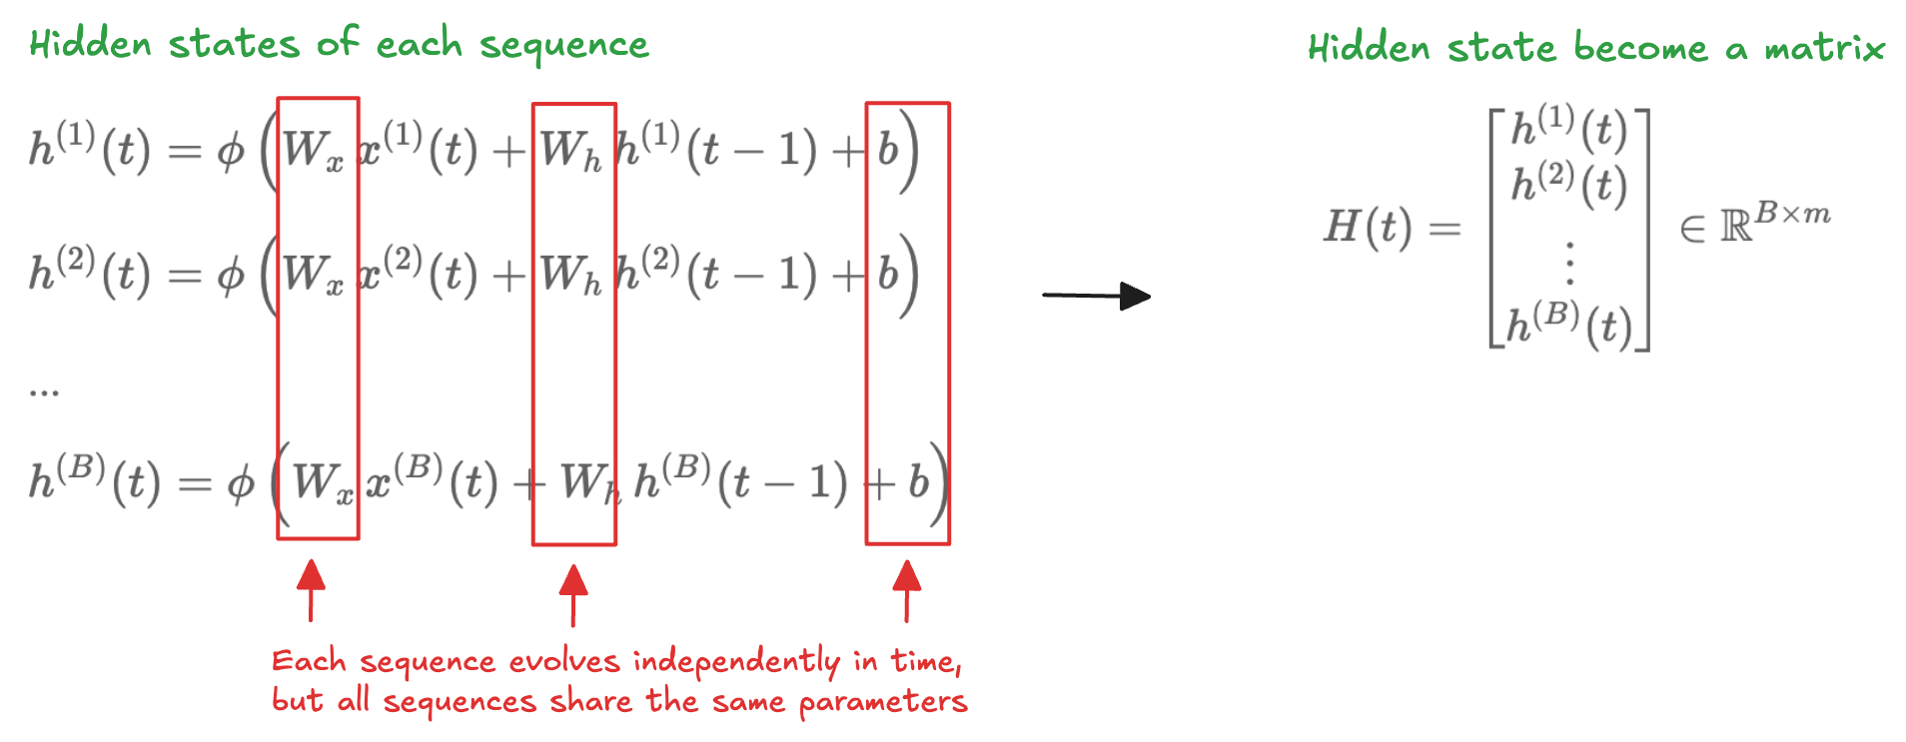
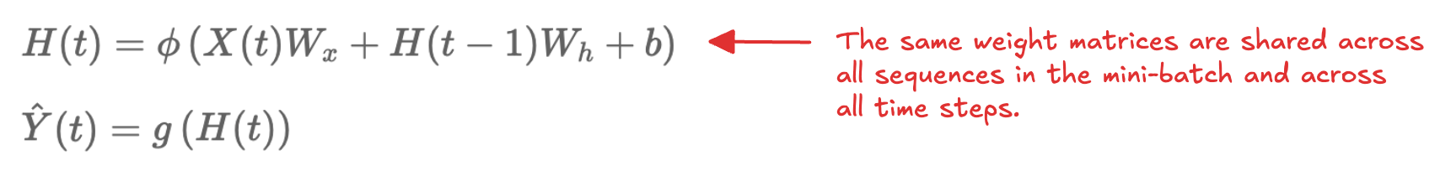
Mini-batches
As for feedforward networks, training use mini-batches:
The hidden state become a matrix:
State update and output are computed simultaneously for all sequences

Slide 27
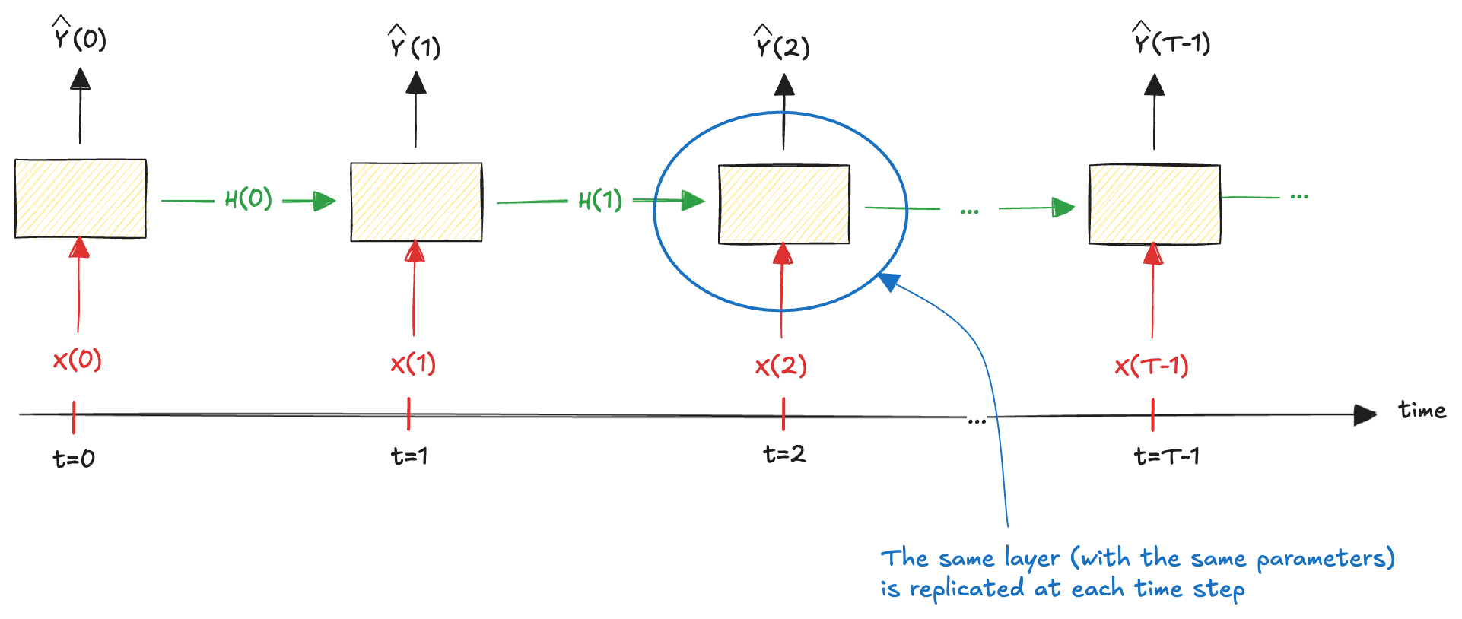
Unrolling through time the layer
As with a single recurrent neuron:
This makes explicit how the hidden state evolves and how information flows forward in time, while emphasizing a crucial property of recurrent networks: parameter sharing across time
Weight matrices and the bias are reused at every time step, allowing the model to process sequences of arbitrary length with a fixed number of parameters

Slide 28
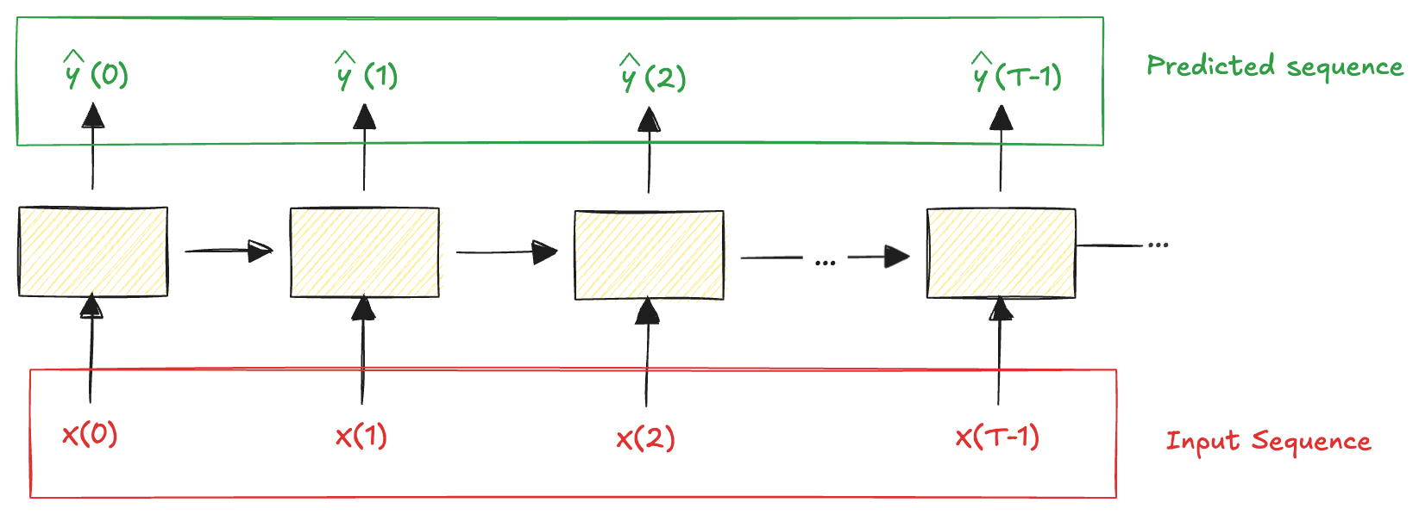
Recurrent Architectures: sequence-to-sequence
Process an entire sequence and produce a corresponding sequence
Example: we feed the network with the household power consumption over the last T days and train it to predict the same sequence shifted one day into the future

Slide 29
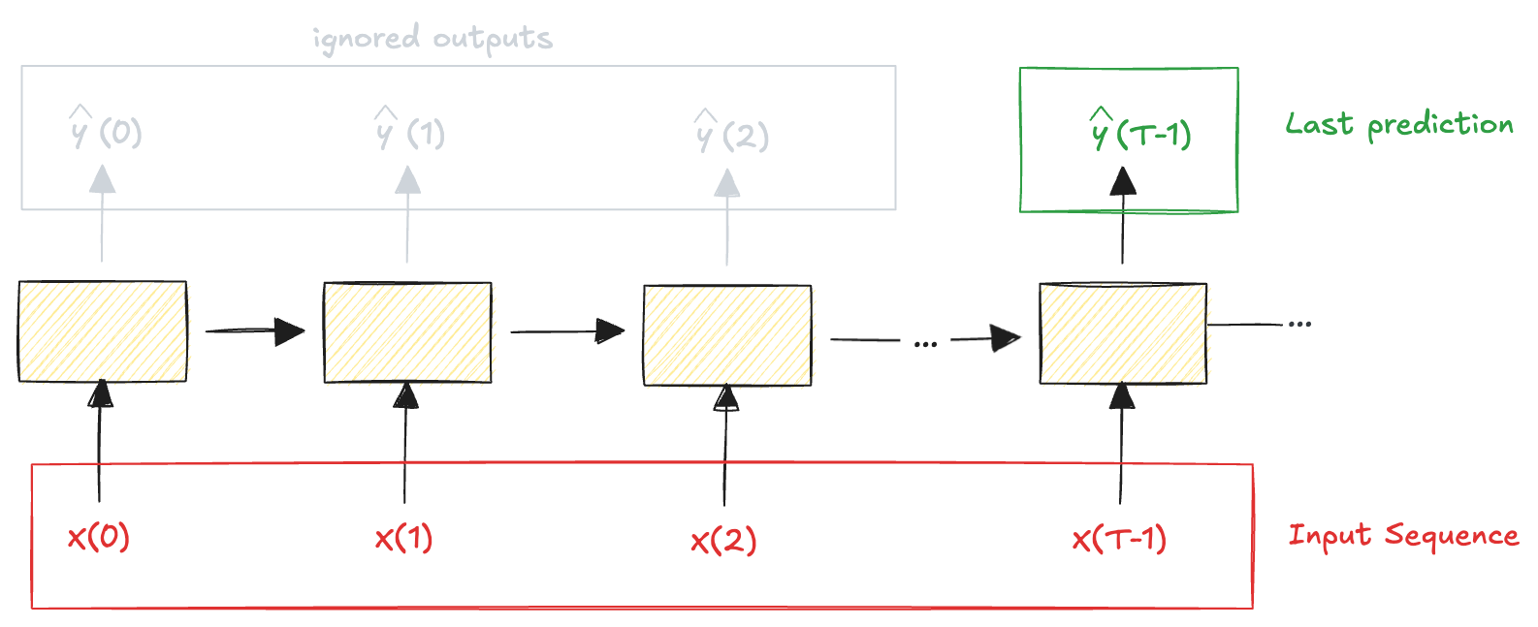
Recurrent Architectures: sequence-to-vector
Feed the network a sequence of inputs and use only the final output
Example: input a sequence of words forming a movie review and output a single sentiment score summarizing the overall opinion expressed in the text
Both architectures can be used to predict values one step into the future; however, they differ in how supervision is applied
sequence-to-sequence: trained to make accurate predictions at every time step
sequence-to-vector: only the final prediction is supervised

Slide 30
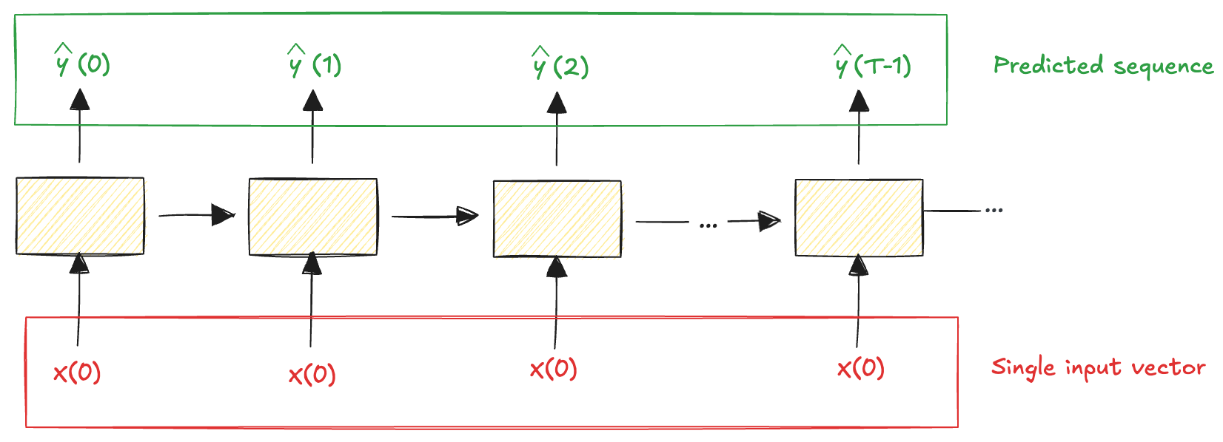
Recurrent Architectures: vector-to-sequence
Provide the network with a single input vector and reuse it at every time step, allowing the network to generate a sequence of outputs
Example: an image is given as input, and the network produces a sequence of words describing the image

Slide 31
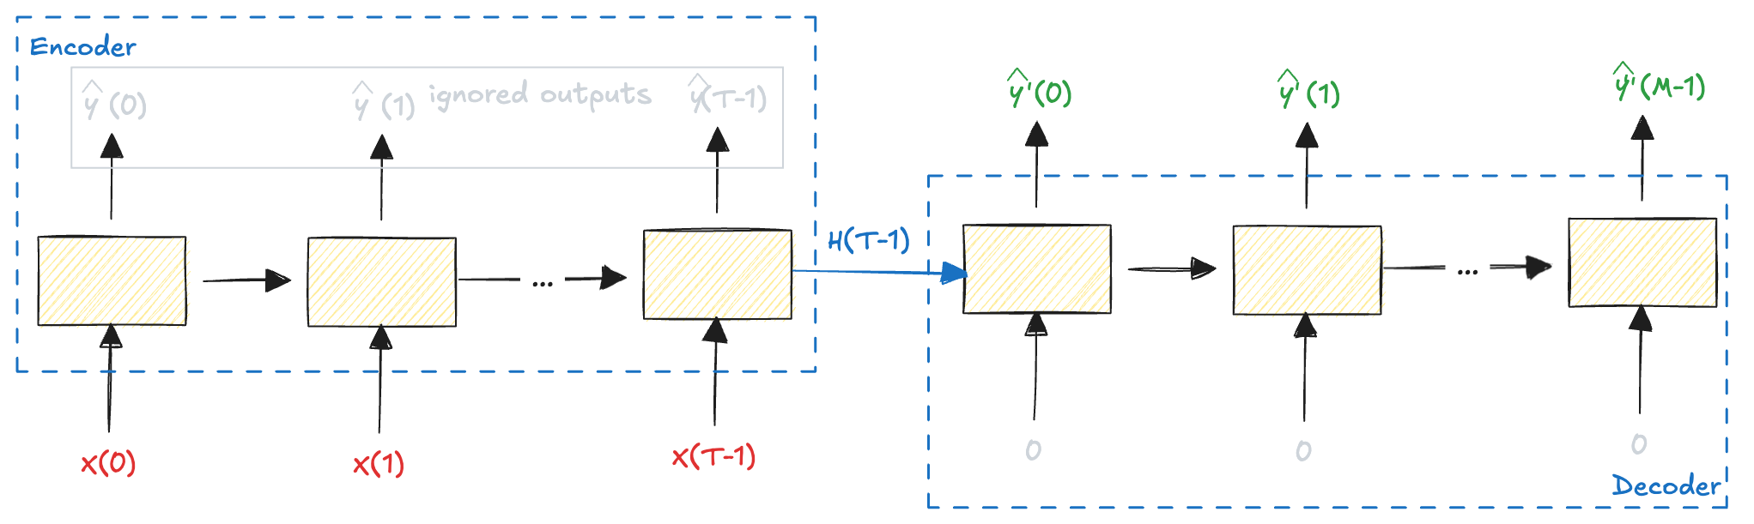
Recurrent Architectures: encoder-decoder
A sequence-to-vector network (encoder), followed by a vector-to-sequence network (decoder)
Example: translating a sentence from one language to another
Notes:
Hands-On Machine Learning with Scikit-Learn,

Slide 32
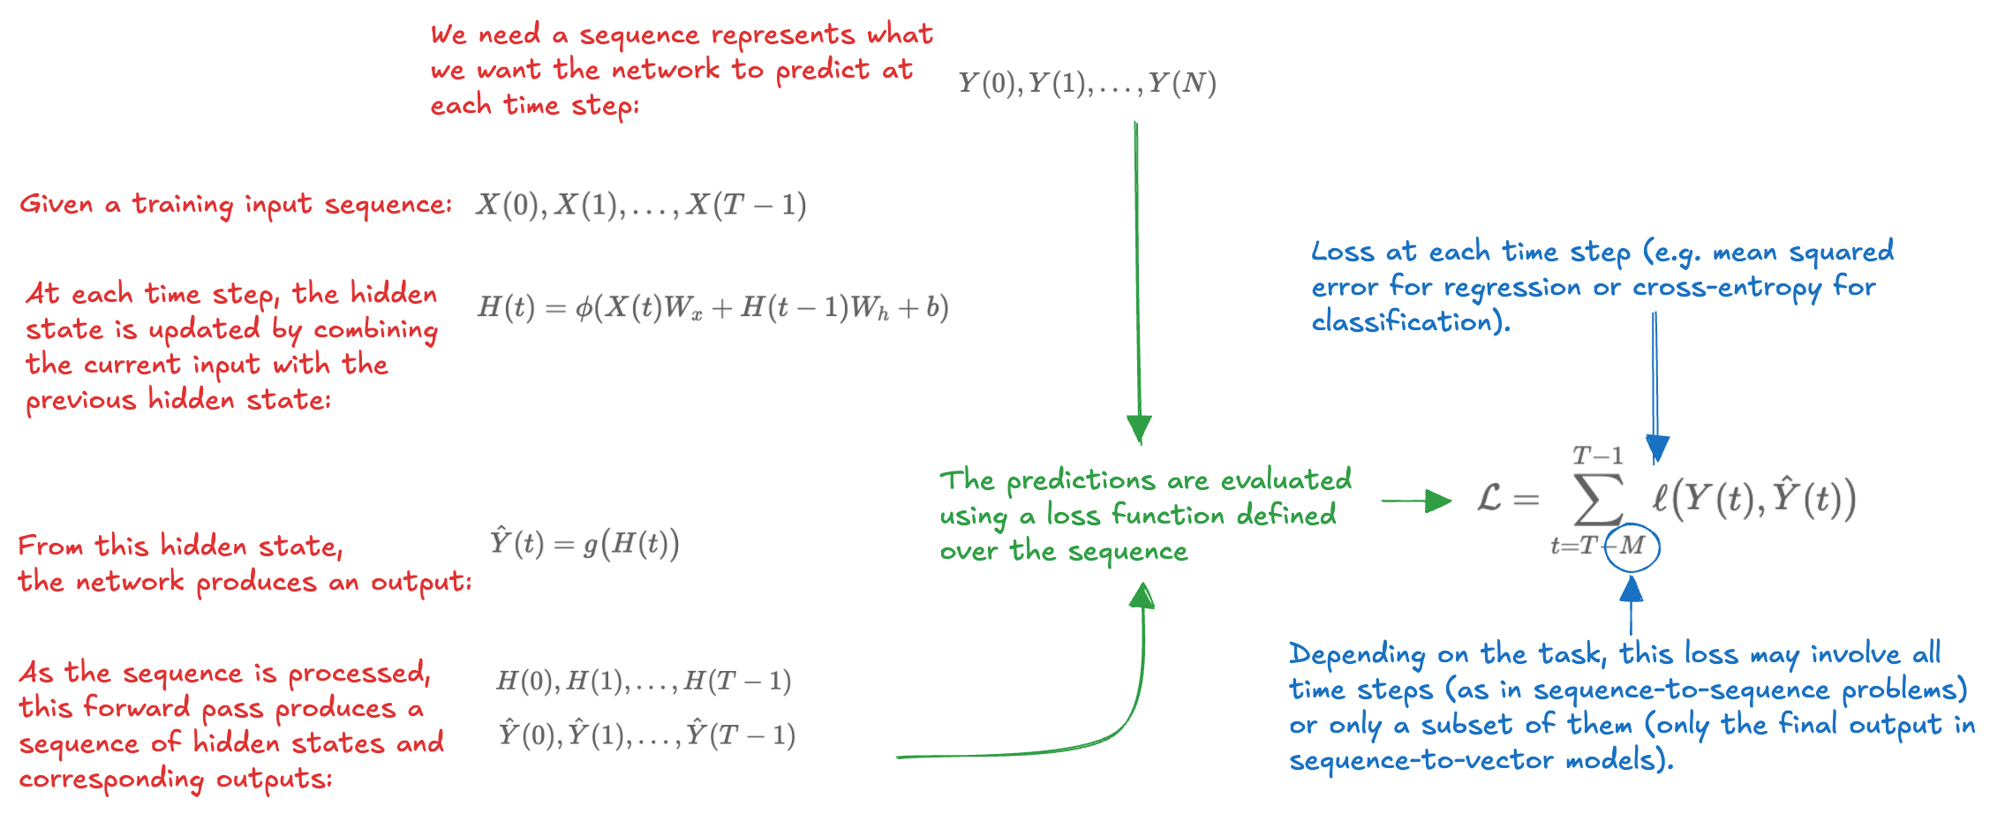
Backpropagation Through Time (1)
Errors does not necessarily originate from current input; it may indicate that relevant information was lost at earlier time steps
During training, the network must learn from the future: errors observed at later time steps should be propagated backward through the sequence to update the parameters used at earlier times

Slide 33
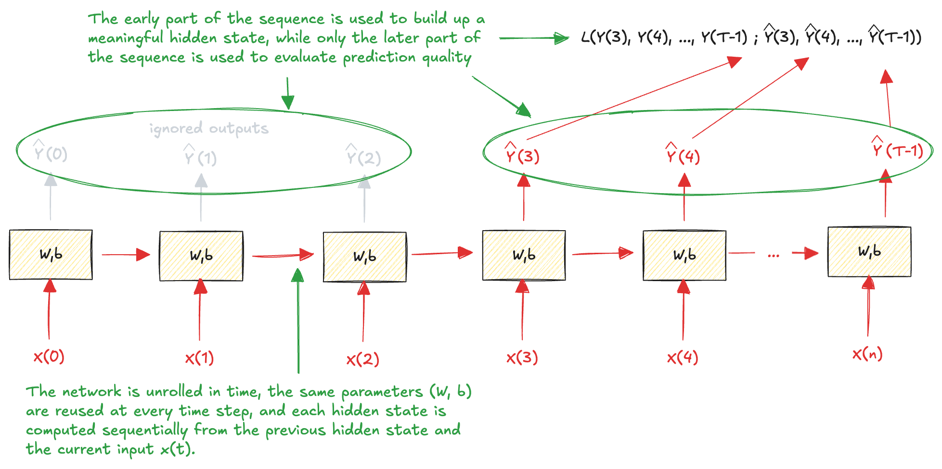
Backpropagation Through Time (2)
Once the loss has been computed, gradients can be propagated backward through the unrolled network

Slide 34
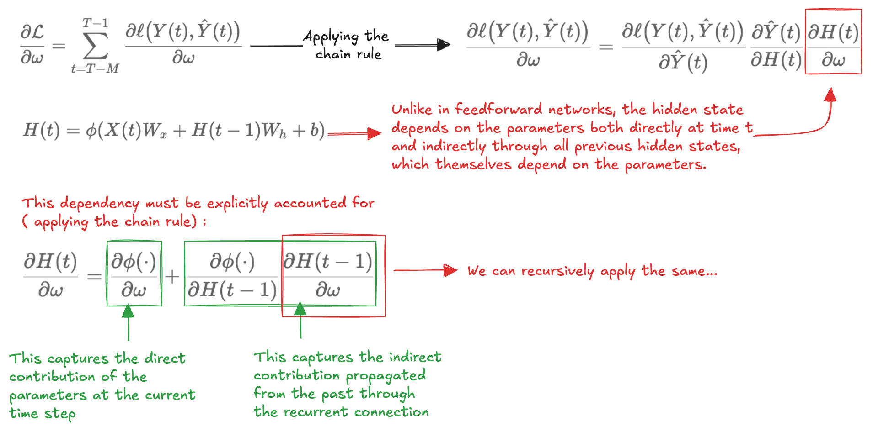
Backpropagation Through Time (3)
To train the model, we need analyse how the loss depends on parameters that are reused at every time step
By recursively applying the relation backward in time, the derivative can be expressed as a sum of contributions from all earlier time steps that propagate their influence forward through the sequence

Slide 35
Truncation length
Sequences can be rather long
Computational problems (too much memory)
Optimization problem (numerical instability)
Input passes through several matrix products before arriving at the output, and others several matrix products are required to compute the gradient
Common practice solution: truncate the unrolling after a fixed number of time steps
Truncation length hyperparameter
A larger truncation length allows the network to capture longer-range dependencies but increases computational cost and memory usage.
A smaller truncation length reduces resource requirements but may limit the network's ability to learn from distant past information.
Balance the need for capturing temporal dependencies with computational efficiency

Slide 36
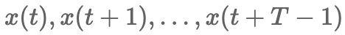
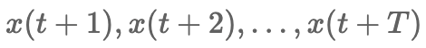
Application to Forecasting
We can use the RNN to build a model for time-series forecasting
to predict future values of a sequence based on its past observations
We adopt a sequence-to-sequence architecture
receives a window of past ridership values as input
produces a sequence of one-step-ahead predictions
The time series must first be transformed into input–target sequences
each input sequence consists of the ridership values observed over the past T days
the corresponding target sequence consists of the same window shifted one step into the future
The RNN processes a window of historical observations and learns to predict the next value at every time step, providing dense supervision across the entire sequence
T determines how much historical information the model can exploit
Large enough to capture the dominant temporal patterns
Not so large as to introduce unstable gradient propagation
Reasonable starting point T = 7 or T = 14

Slide 37
XXX
XXXX

Slide 38
XXX
XXXX

Slide 39
XXX
XXXX

Slide 40
XXX
XXXX

Slide 41
XXX
XXXX

Slide 42
XXX
XXXX

Slide 43
XXX
XXXX

Slide 44
XXX
XXXX

Slide 45
Exercise
1 - xxxx

